Slide 1

MeuAssistBot
Graduation Project 1 Report

Slide 2

Introduction
Problem Statement and Purpose
Project and Design Objectives
Intended Outcomes and Deliverables
Motivations
Report Outline

Slide 3
Problem Statement
At Middle East University (MEU), the student support system often experiences high demand, leading to extended wait times and decreased efficiency. Traditional methods of support, such as face-to-face consultations, email, and phone calls, are not scalable and fail to meet the needs of students who require immediate assistance. This results in student frustration and a suboptimal academic experience. There is a need for a scalable, efficient, and accessible solution to provide academic support to students at any time.

Slide 4
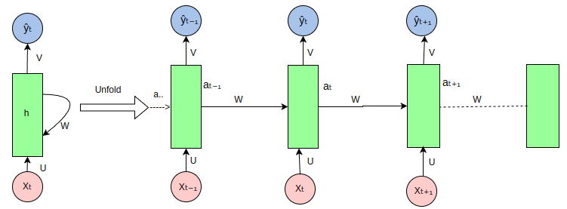
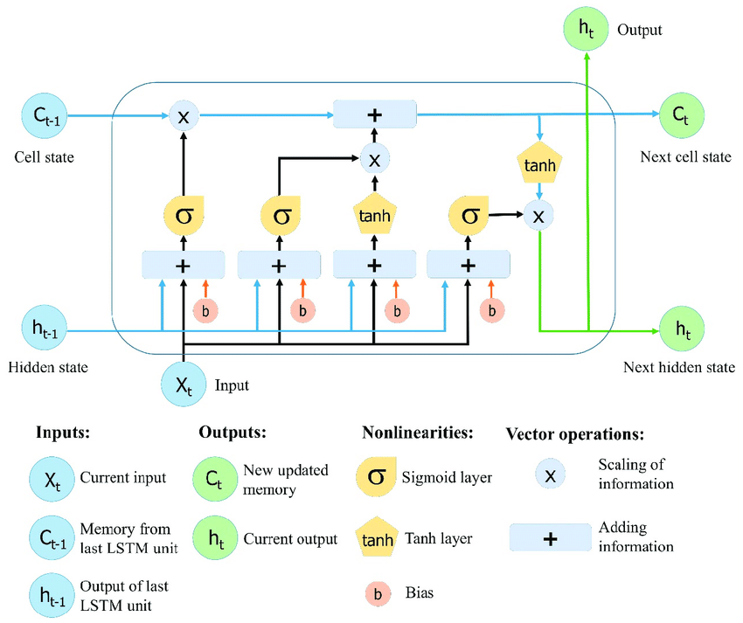
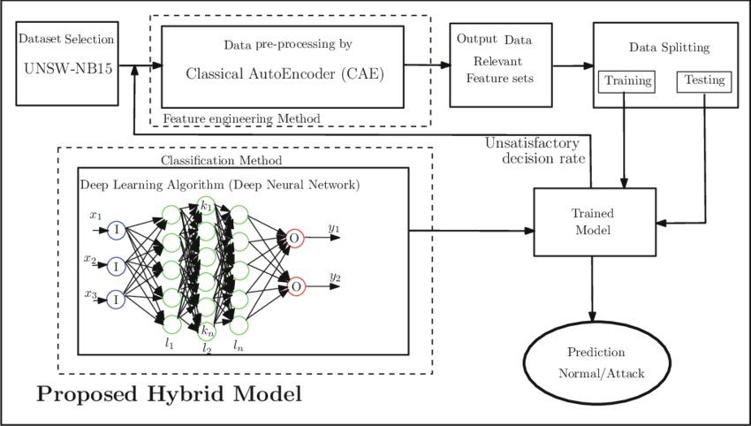
Background
The MeuAssistBot project leverages AI and machine learning to enhance student support at Middle East University. Traditional support methods, like face-to-face consultations and emails, face limitations in scalability and efficiency.
AI Co-workers
AI co-workers, like chatbots, assist humans in various tasks. In this project, the chatbot provides academic support to students.
Machine Learning and Deep Learning
ML and DL train algorithms on large datasets to make predictions. These technologies are essential for developing intelligent chatbots.
Recurrent Neural Networks (RNNs)
RNNs are effective for sequential data tasks like language modeling and speech recognition.
Transformer Models
Transformers, such as BERT and GPT, use self-attention mechanisms for parallel processing, significantly improving NLP tasks.
Transfer Learning and Fine-Tuning
Transfer learning adapts pre-trained models to specific tasks, and fine-tuning enhances performance with task-specific data.
Previous Research
AI chatbots reduce response times, increase user satisfaction, and free up human resources. Universities like ASU and Georgia Tech have successfully implemented AI-driven chatbots for 24/7 support.
Motivation for Using AI
AI offers timely, scalable, cost-effective, and personalized academic support, ensuring availability around the clock.

Slide 5
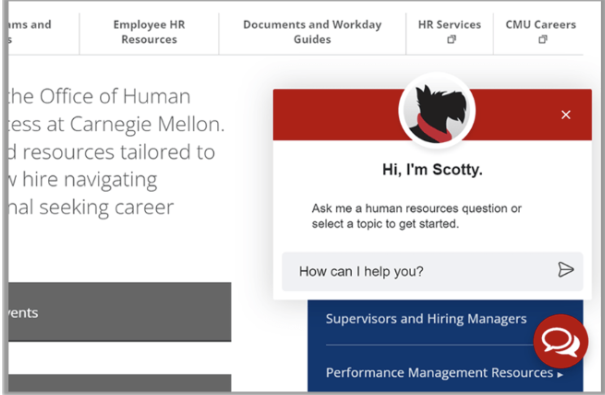
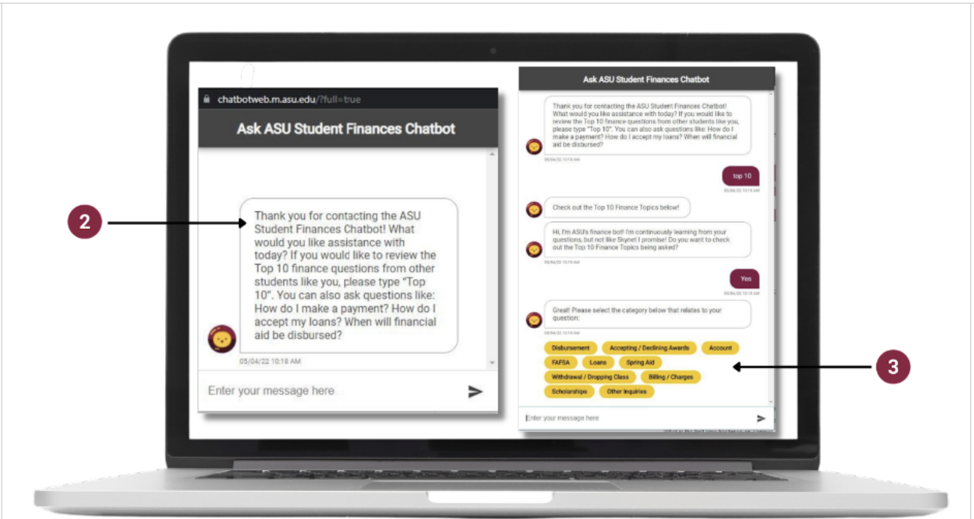
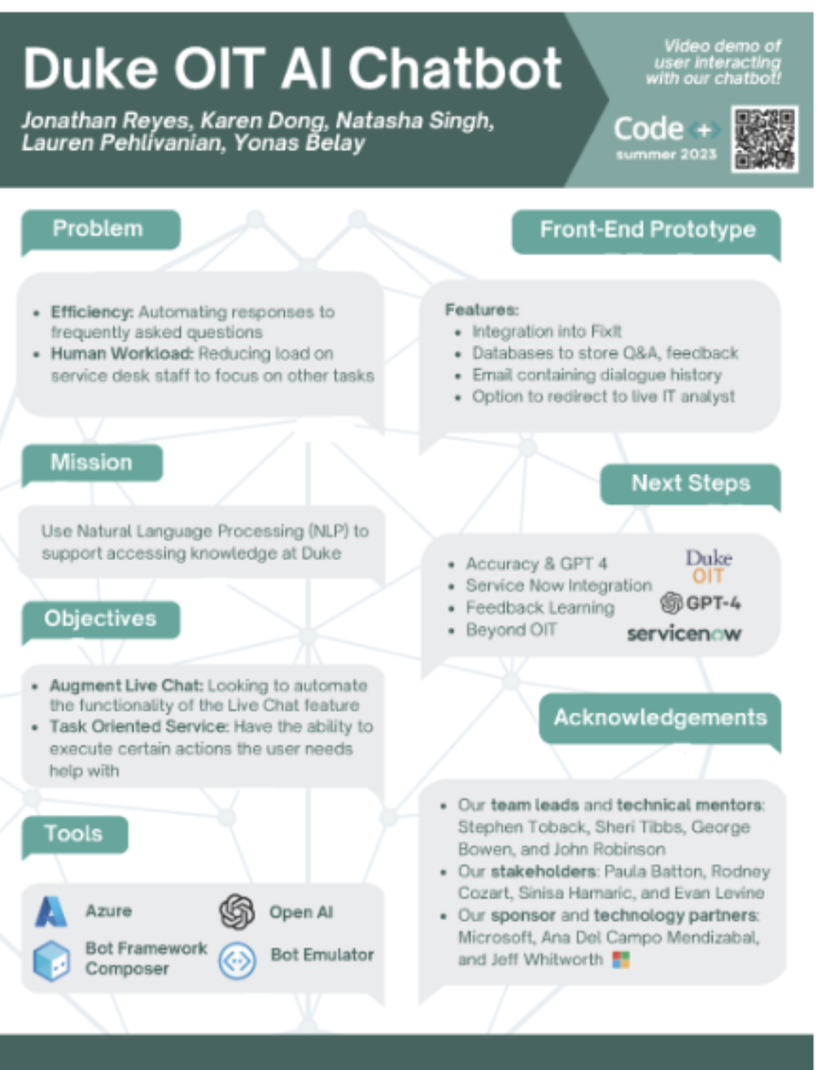
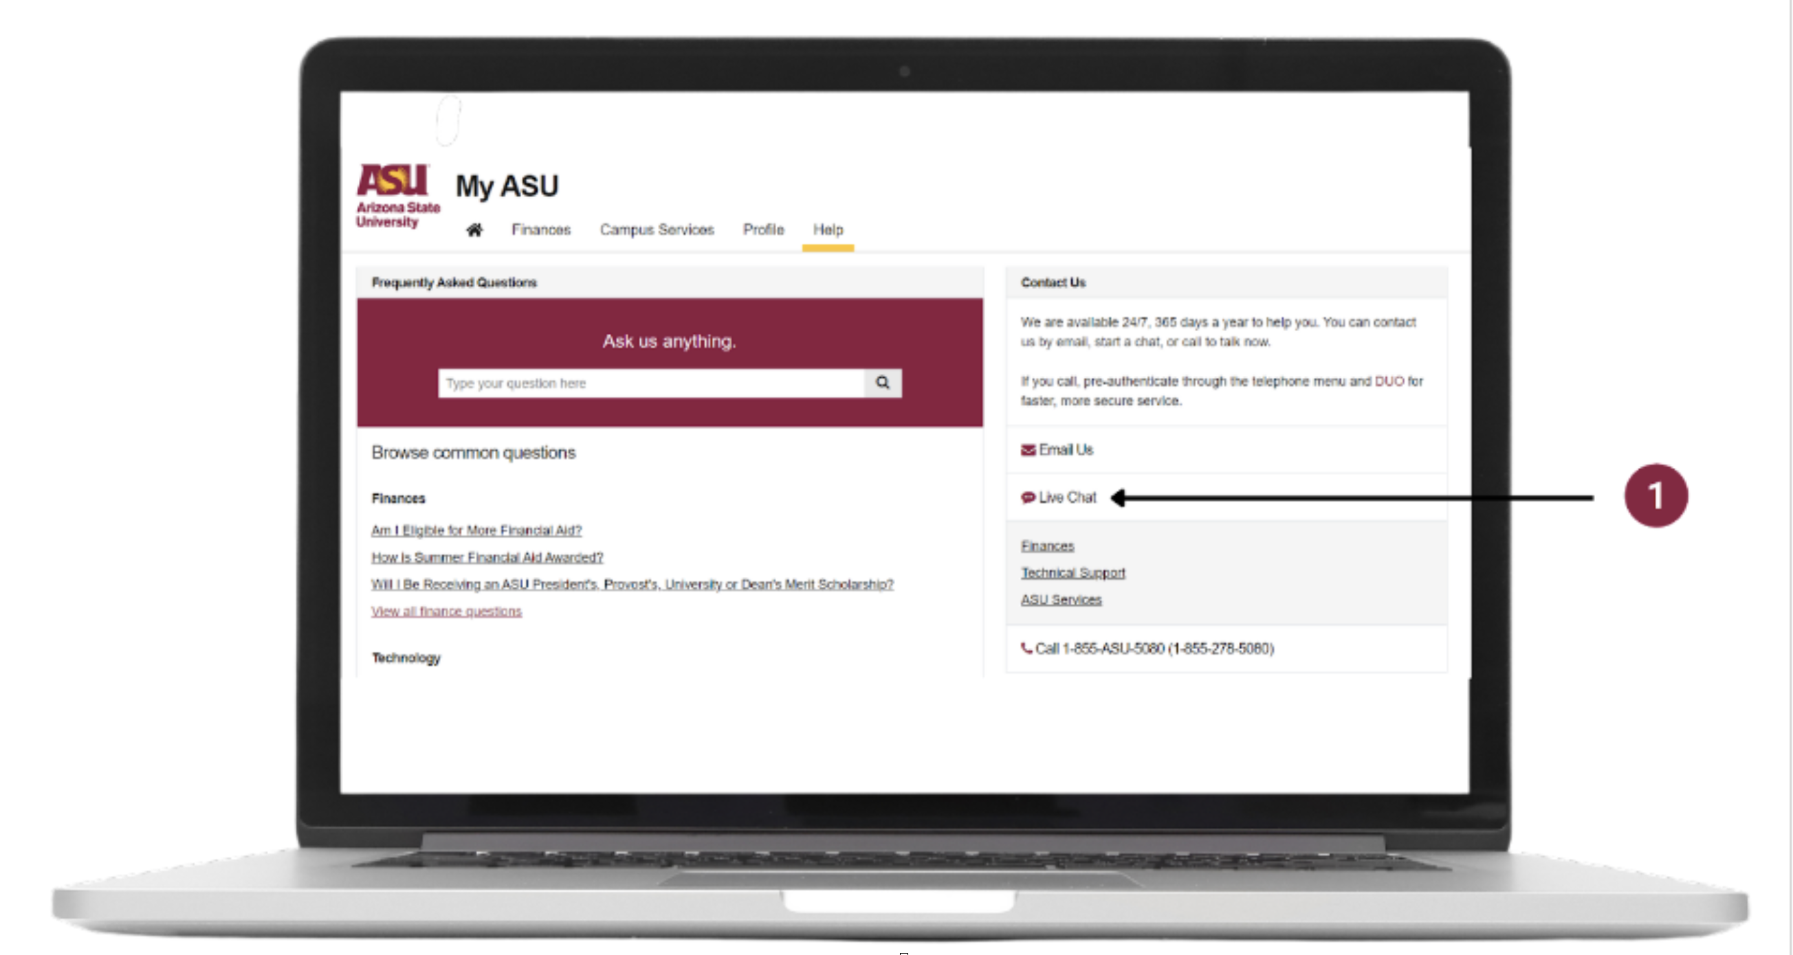
Literature Review
Arizona State University
Georgia Tech
Carnegie Mellon University (CMU)
Duke University
Virginia Commonwealth University
Conclusion

Slide 6
Scope
The scope of the MeuAssistBot project includes the development and deployment of an AI-driven chatbot designed to provide academic support to students at MEU. The chatbot will be integrated with the university’s existing systems and will be accessible via web and mobile platforms. The project will cover the following areas:
- User interface design for both students and administrators.
- Backend server development for processing requests and managing data.
- Implementation of machine learning models to handle natural language queries.
- Integration with existing university systems for real-time data access.
- Continuous improvement based on user feedback.

Slide 7
Objectives
1. Develop a User-Friendly Interface.
2. Ensure Accurate and Secure Information Delivery.
3. Design for Scalability.
4. Timely Deployment.
5. Continuous Improvement.

Slide 8
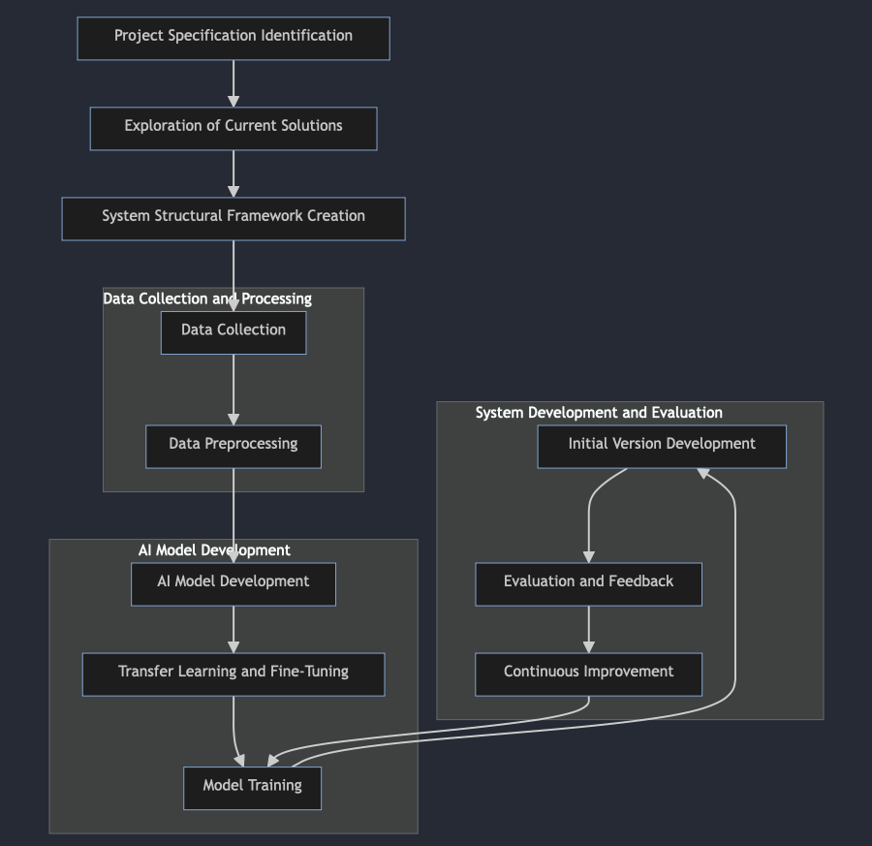
Methodology
The development of MeuAssistBot will follow a structured methodology divided into several phases:
1. Requirement Analysis
2. Design
3. Data Collection and Pre-processing
4. Model Training
5. Development
6. Testing
7. Deployment
8. Evaluation and Improvement

Slide 9
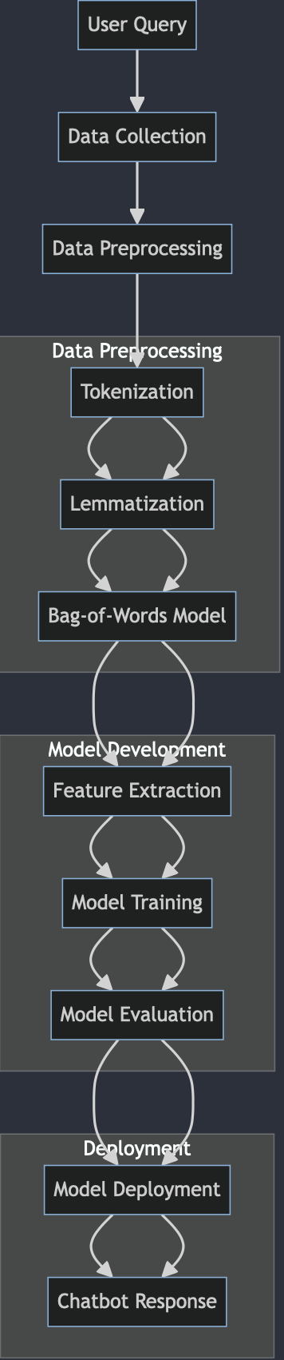
Dataset
Dataset
Data Selection
Description
Collection
Pre-processing
Data Processing for Model Understanding

Slide 10
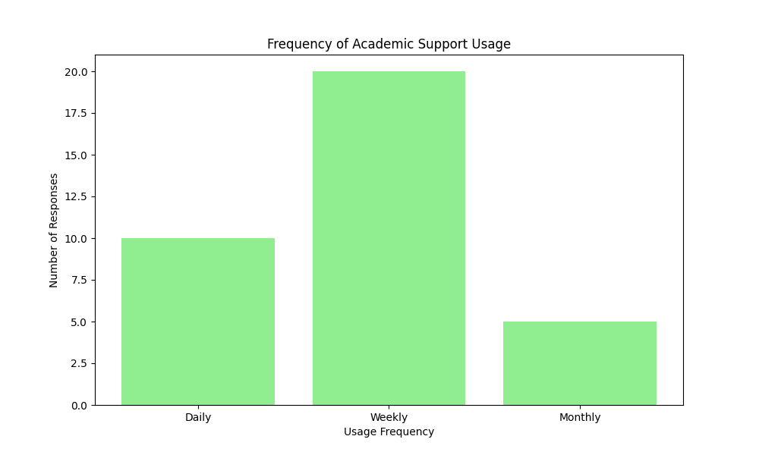
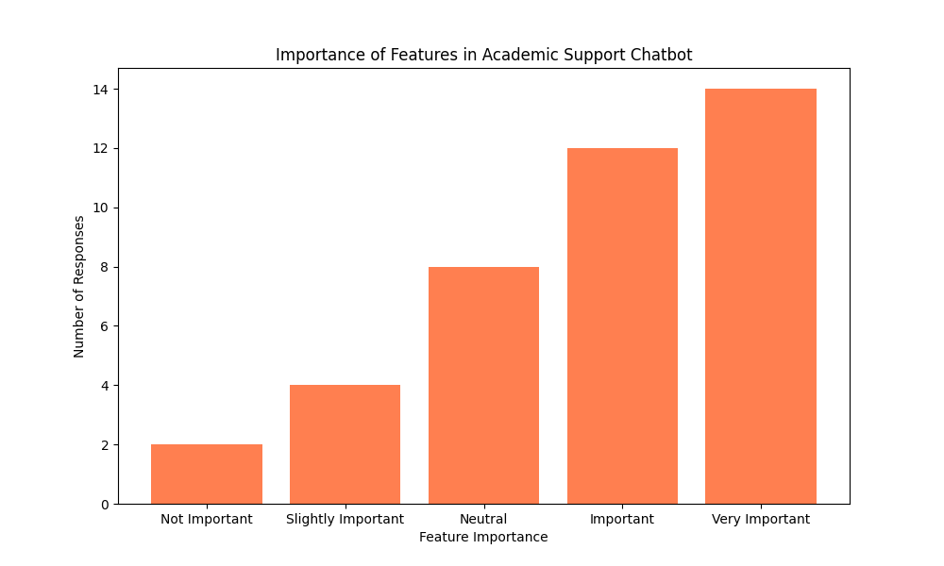
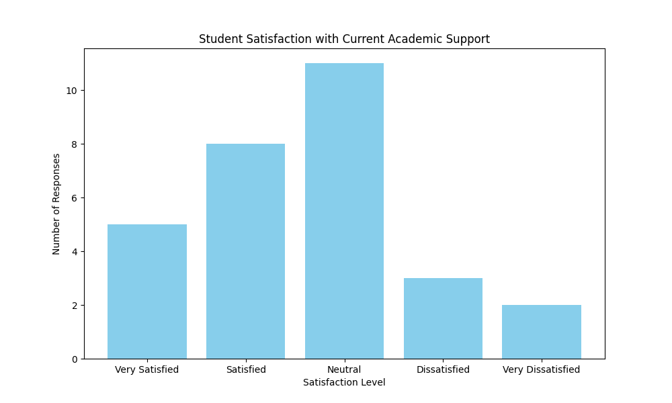
Results
Introduction
Survey Results
Conclusion

Slide 11
MEU AssistBot: Enhancing Student Support with AI
Project Aim: Develop an AI-driven chatbot designed to assist Middle East University students by providing quick, accurate, and secure academic support.
Key Features:
24/7 Availability: The chatbot is available round-the-clock to answer student queries.
Scalability: Capable of handling a large number of users simultaneously.
Multi-Language Support: Provides responses in both English and Arabic.
User-Centric Design: Interface tailored to student needs, focusing on usability and accessibility.
Technologies Used:
Backend: Flask
Frontend: React
Model: GPT-3 based models fine-tuned for understanding and generating Arabic and English text.

Slide 12
Implementation and Performance of GPT-Based Model
Model Selection:
GPT-3 Based Model: Chosen for its state-of-the-art natural language understanding and generation capabilities.
AraBERT Integration: To enhance Arabic language support, AraBERT was considered for specific tasks.
Model Training:
Data Sources:
University helpdesk records, student surveys, and manually generated questions.
Fine-tuning the model on a dataset containing academic and administrative queries.
Training Process:
Transfer Learning: Leveraged a pre-trained GPT-3 model.
Fine-Tuning: Adjusted the model using domain-specific data to improve response accuracy.
Performance Metrics:
Accuracy: 93%
Precision: 92%
Recall: 89%
F1 Score: 90.5%

Slide 13
Discussion
Interpretation of Results
Implications for Academic Support
Strengths and Weaknesses

Slide 14
Conclusion
The MeuAssistBot project aims to revolutionize the academic support system at Middle East University by introducing an AI-driven chatbot. This solution is expected to significantly reduce wait times, improve the efficiency of support services, and enhance the overall student experience. By leveraging advanced machine learning techniques and a robust system architecture, the project will provide scalable, accurate, and timely assistance to students. The successful implementation of MeuAssistBot will not only benefit the current student body but also set a precedent for future technological advancements in academic support systems at MEU.

Slide 15
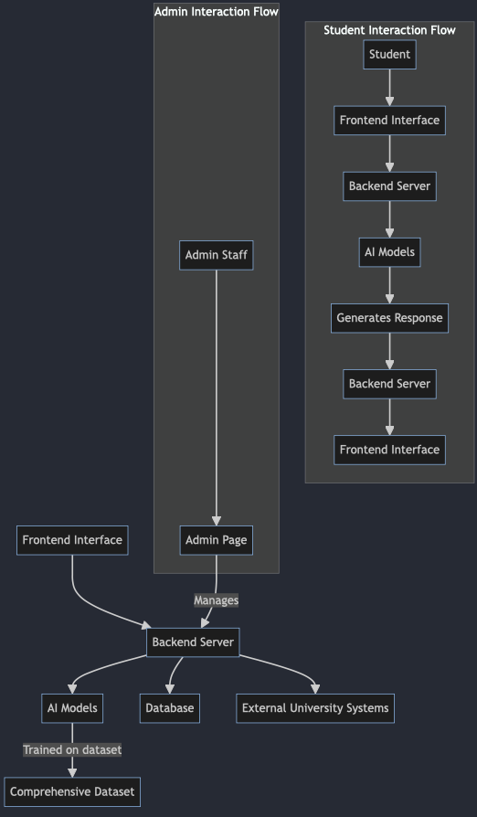
System Architecture
Overview
Frontend Interface
Backend Server
AI Models
Admin Page
Interaction Flow

